Slide 1
Data Modelling Steps
Loading the data
Missing Value Percentages Evaluation
Imputing the Missing Values
Analyzing numerical and categorical features
One hot Encoding Nominal Categorical Variables
Label Encoding Ordinal Categorical Variables
Scripting Linear Regression (Gradient Descent, Mini Batch Gradient Descent, Stochastic Gradient Descent)

Slide 2
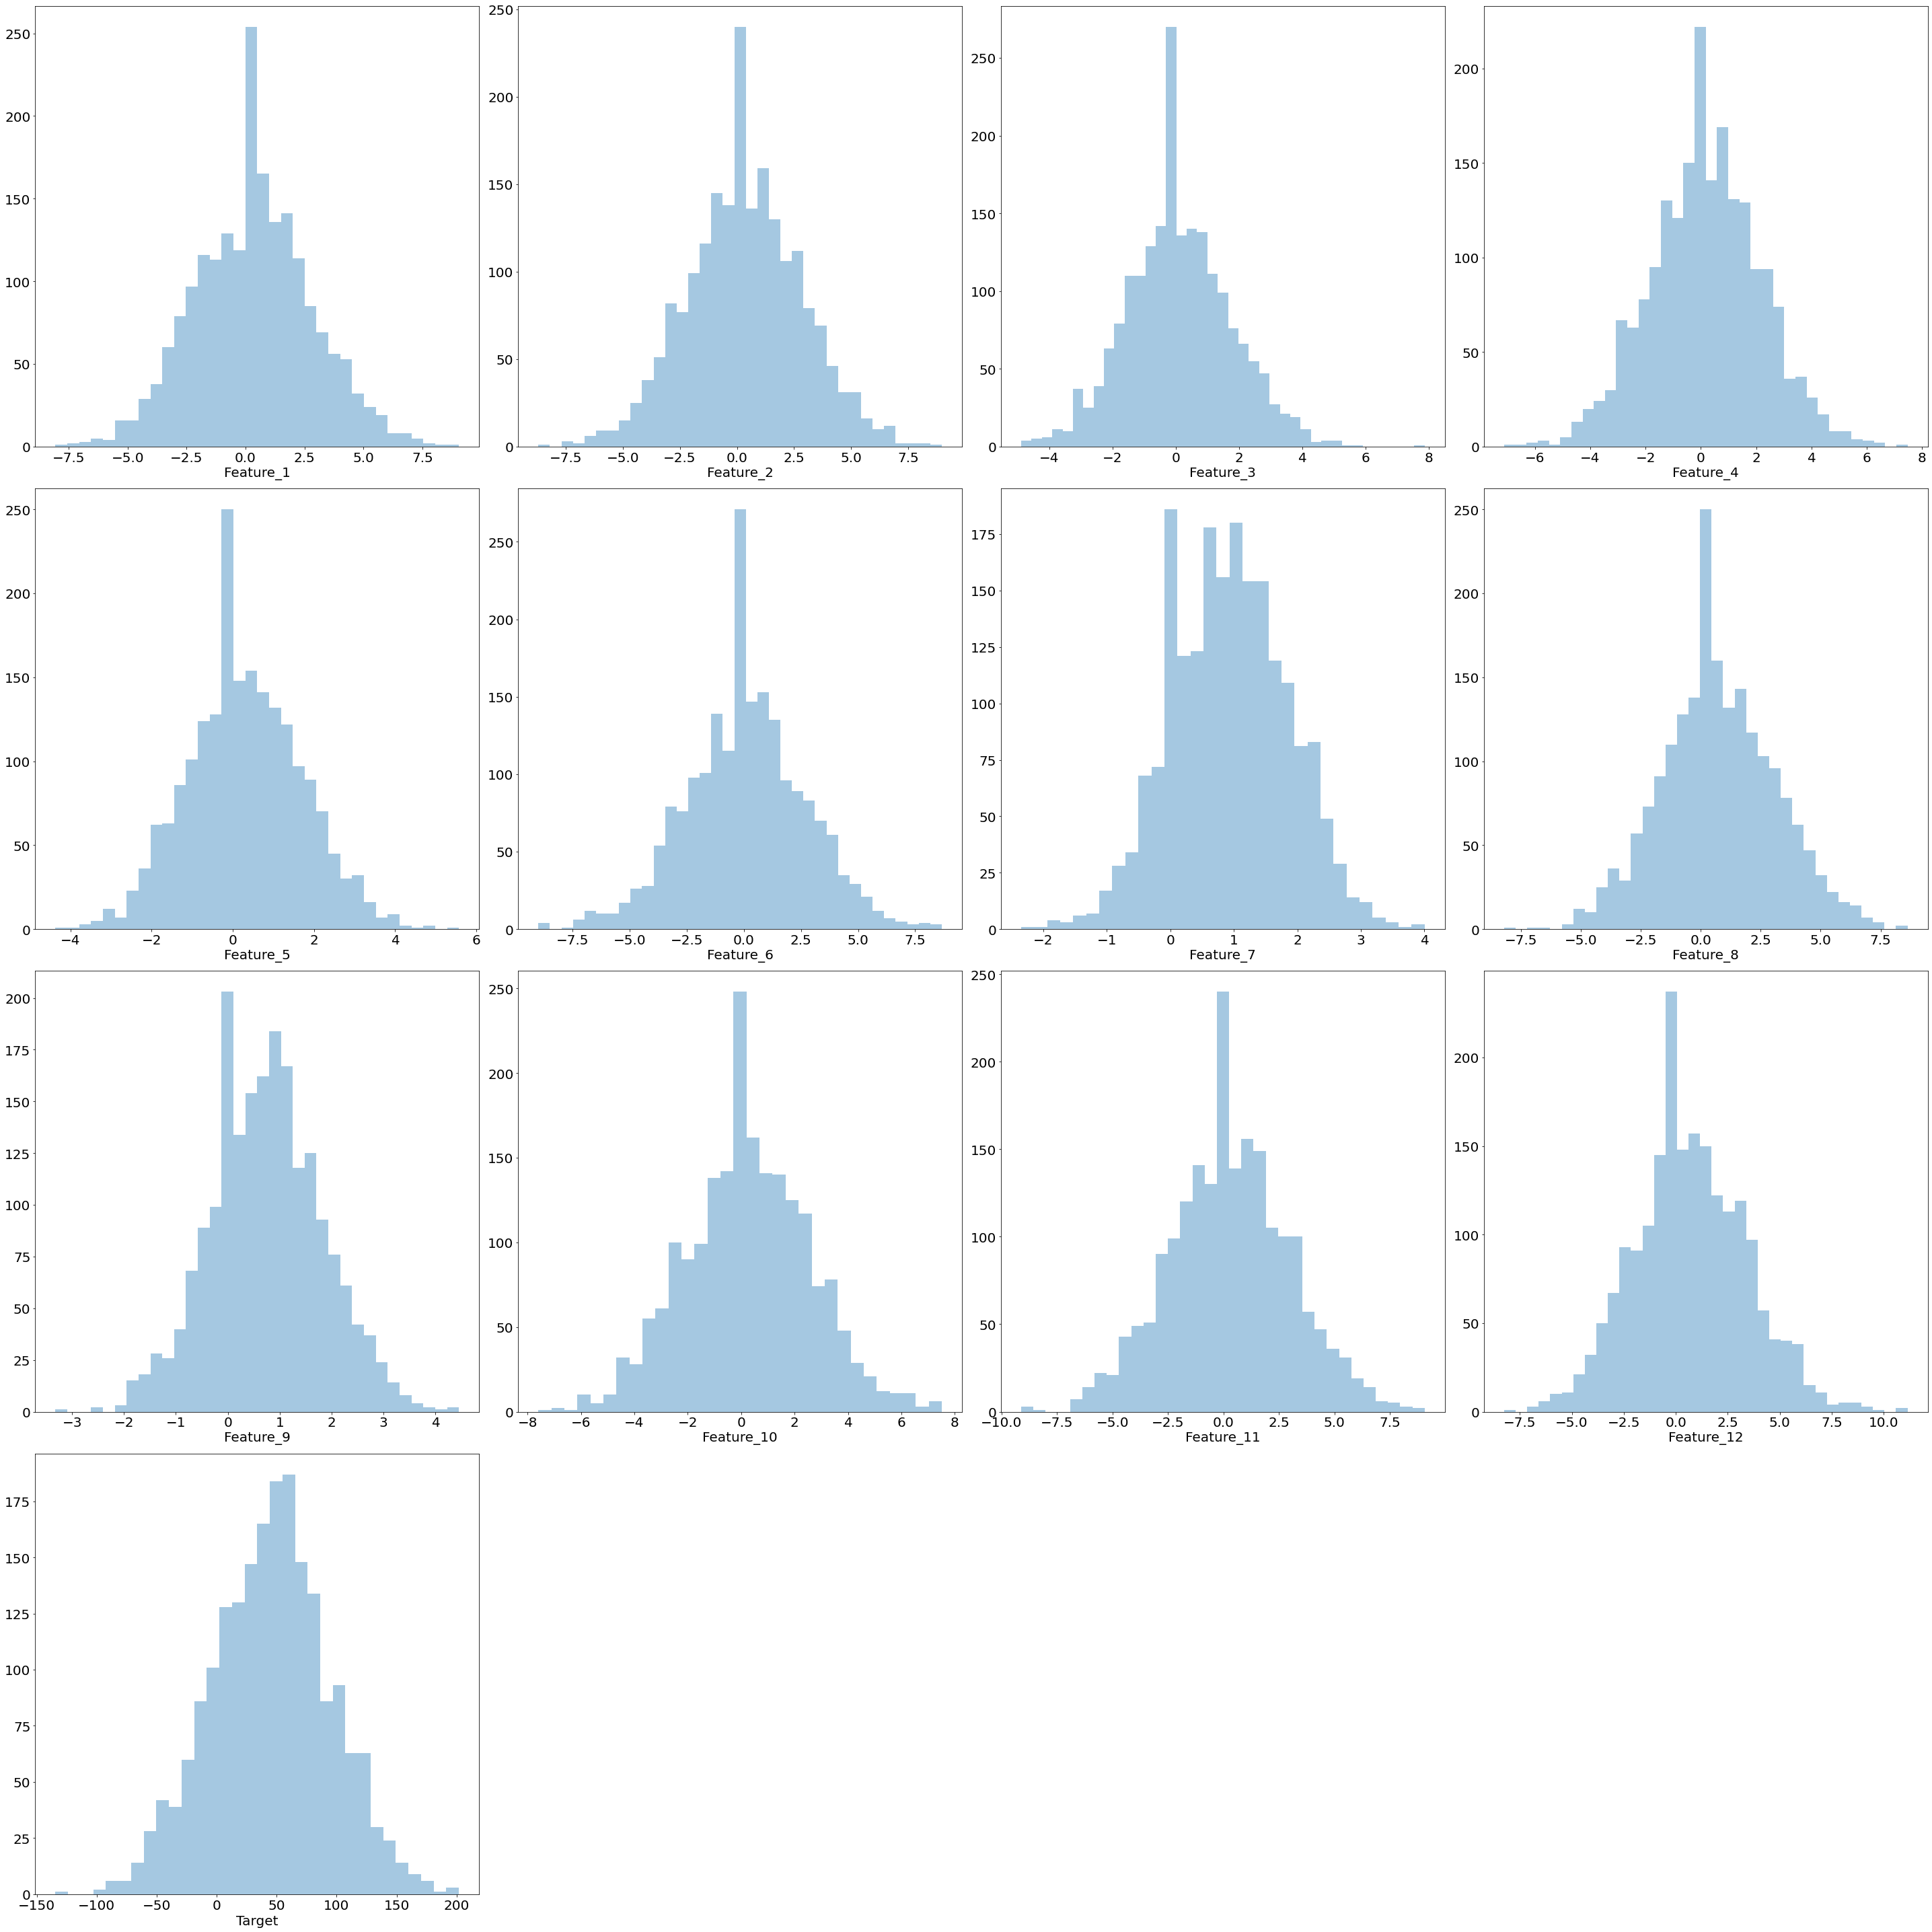
Numerical Variables Visualization
All numerical variables follow normal distribution.
Linear Regression assumption of normality is followed
No zero variance features

Slide 3
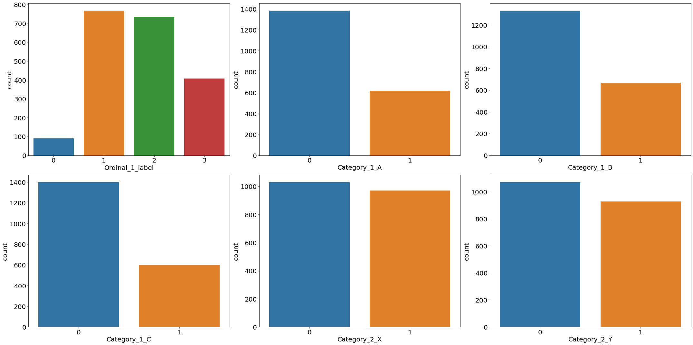
Categorical Variables Visualization
Count Plot of ordinal and nominal categorical variables is shown after one hot and label encoding.
No Zero Variance Features

Slide 4
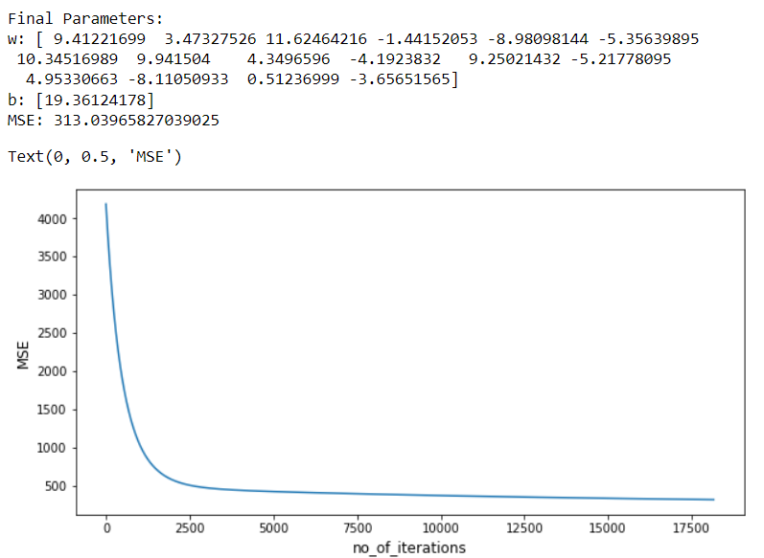
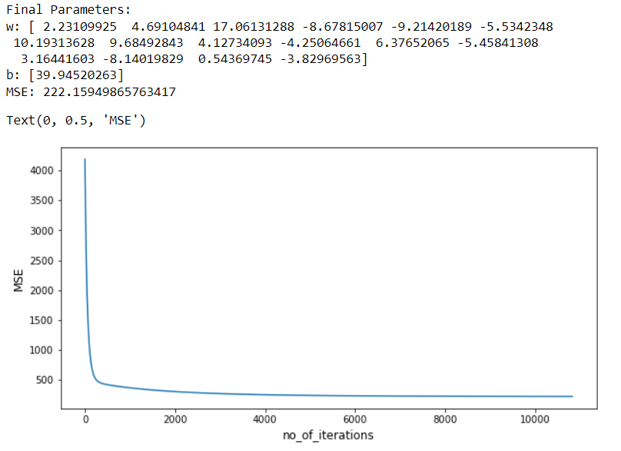
Gradient Descent Algorithm
The plot of Mean Squared Error (J) vs iteration is shown.
Learning Rate alpha is chosen as 0.0001 and 0.001 Tolerance is chosen as 0.001
If difference in the parameters w and b of successive iterations is less than or equal to the certain chosen tolerance then it means the algorithm has been converged.
Alpha=0.0001
Alpha=0.001
We can see that the algorithm when run with high learning rate show a steep decrease in MSE at first in contrast to slow and gradual decrease of MSE when low value of learning rate is chosen.

Slide 5
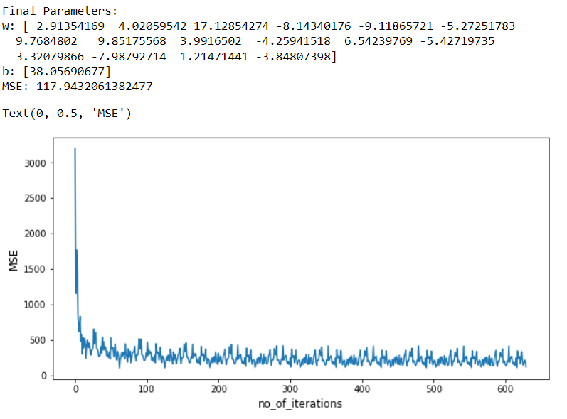
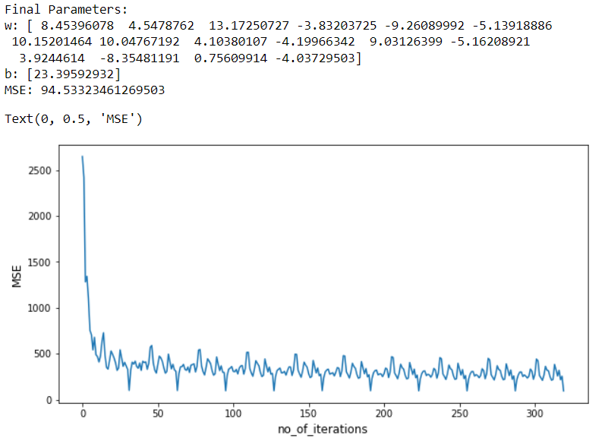
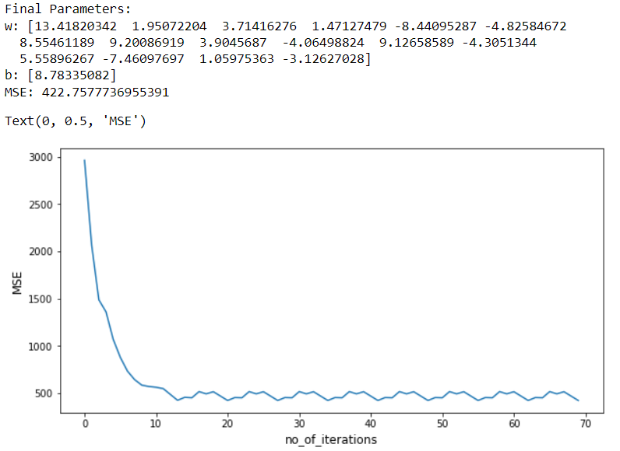
Mini Batch Gradient Descent Algorithm
Batch Size=32
Batch Size=64
Batch Size=300
Parameters Chosen :
Alpha = 0.00001
Tolerance = 0.001
Epochs = 10
Number of Observations = 2000
Observation : Gradient Descent with smaller batch sizes are noisy. Also the smaller loss is associated with
smaller batch size.

Slide 6
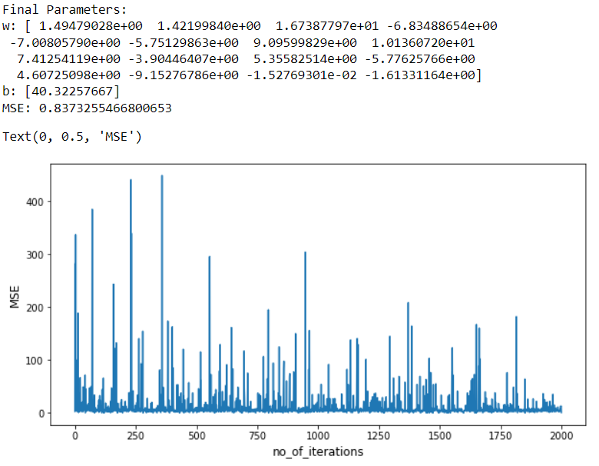
Stochastic Gradient Descent Algorithm
Parameters Chosen :
Alpha = 0.00001
Tolerance = 0.001
Epochs = 1
Number of Observations = 2000
In Stochastic Gradient Descent parameter update takes at each training example. Its just a Mini Batch Gradient Descent where batch size equals to 1.
Observation :Stochastic Gradient Descent takes a very noisy path in its attempt to reach global minimum.
In fact it may never reach global minimum but it will keep oscillating around the global minimum.

Slide 7
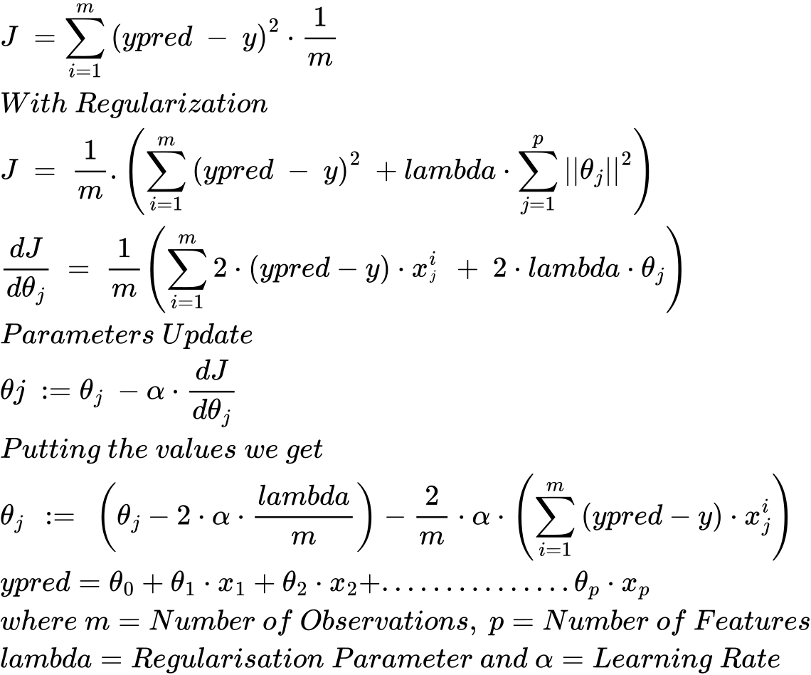
L2 Regularization
With L2 Regularization we are just trying to reduce the model complexity by penalizing the parameters.

